Slide 1
Operating Systems and Architectures CSCM98, Lecture 2: Programs, Processes and Threads
Dr. Benjamin Mora
1
Swansea University
Benjamin Mora

Slide 2
Content
Role of the Kernel.
Processes & Threads.
Loading and Linking.
Interrupts.
Examples in C (Thread and Process creation) and C++11.
2
Swansea University
Benjamin Mora
Notes:
Possibly quickly discuss event programming and multi-processor as well

Slide 3
OS Kernel
3
Swansea University
Benjamin Mora

Slide 4
Role of the Kernel
The Kernel implements all the necessary tools for an Operating System to run and manage the computer.
A collection of programs that are executed with OS privileges.
A big focus on Inputs/Output (I/O) and managing resources.
Drivers.
Kernel code is protected from user.
Sometimes refers to a program linked to a System Call or a specific action.
Kernel Modules
4
Swansea University
Benjamin Mora

Slide 5
Role of the Kernel
System calls are often made by applications/programs.
E.g., print a message on screen.
Application not necessarily involved (e.g., exception).
These calls are handled by the OS in Kernel space (i.e., kernel or supervisor mode).
As opposed to User space.
System calls are usually slow and should be minimized.
Requires context switching.
Calling thread is put on hold.
Implementing concurrency may require many system calls (Creation, synchronization & communication) !!!
5
Swansea University
Benjamin Mora

Slide 6
Monolithic Kernels
Protection level
User mode
Application(s)
System call
File System
IPC
Kernel mode
Scheduler, Virtual memory
Device Drivers
Hardware
6
Swansea University
Benjamin Mora

Slide 7
Monolithic Kernels
Monolithic Kernels implement all the different components of an OS, but with some dependencies.
Difficult to implement as the OS and its functionalities grow.
A bug in kernel mode can compromise the entire system.
Micro-Kernels have been developed as a solution.
7
Swansea University
Benjamin Mora

Slide 8
Micro Kernels
Ring 2 or 3
User mode
…
Application(s)
Device Drivers
File Server
Virtual Memory
Privileges/
Protection level (Ring)
Kernel mode
Micro-Kernel (Basic IPC, Virtual Memory and Scheduling )
Ring 0
Hardware
8
Swansea University
Benjamin Mora
Notes:
Only Ring 0 applications can access crucial elements of the hardware directly.

Slide 9
Micro Kernels
Benefits:
Uniform Interfaces.
Flexibility.
Reliability.
Portability.
Extensibility.
…
Lower Performances.
Communications done by message passing.
Micro Kernel Modules or Services can be easily loaded without reboot or rebuilding the kernel.
9
Swansea University
Benjamin Mora
Notes:
Extend notion of rings and user modes!

Slide 10
Micro Kernels
Rings:
Protection at different levels.
Prevents code to get access to resources outside of their scope of application (Sandboxing).
X86 processors have 4 levels of protection.
Supported by the Hardware (processor)
Would be too slow otherwise.
2 bits for a page description.
For instance, a web applet should not get control of
your webcam as it is running in user-mode
(ring 3, least privilege).
Ring 3:
User Mode
Ring 1 & 2:
Device Drivers
Ring 0:
Kernel
10
Swansea University
Benjamin Mora
Notes:
Extend notion of rings and user modes!

Slide 11
Processes
11
Swansea University
Benjamin Mora

Slide 12
Introduction to Processes: Topics
Program Life span/Process definition.
Program vs Process.
Code execution.
Java threads.
Process memory.
Stack & Call stack.
Processes and Threads.
Process states.

Slide 13
Program vs machine code vs Binary
");
13
Swansea University
Benjamin Mora

Slide 14
Program vs machine code vs Binary
Program
Evolves as you write it!
Machine code
From the compilation of your program!
Or from interpretation (e.g., Java virtual machine)
Store on disk as a program.
Binary code
A binary representation of the machine code interpretable by processor.

Slide 15
Program lifespan
Source Code, High Level Language
Compilation/Interpretation
Compiled or Interpreted Code
(.exe, Java PCode, etc…)
Program Loaded by OS. Creation of context.
Runable program
Execution by CPU
Process running
Possible creation of new threads
Additional threads running
15
Swansea University
Benjamin Mora

Slide 16
CPU and Code execution
i=i+1;
MOV R1, i
ADD R1, #1
MOV i, R1
ALU
PC
Stack Pointer and Program Counter
SP
i
3
4
R1
3
4
Registers
R2
Memory
CPU
Swansea University
Benjamin Mora
16
Notes:
Yellow: Program
Pink:Data

Slide 17
CPU and Code execution
The execution of a program is mainly sequential.
Only a single basic instruction at a time (single processor).
Well, not so true for modern processors …
Multithreading.
Operating systems are multi-tasked while some processors have a single core. How is it possible to execute two different codes simultaneously ?
Real-Time code interleaving is obviously not possible.
One strength of the OS is its ability to quickly switch between different programs.
Task 1
Task 1
Task 2
…
t
17
Swansea University
Benjamin Mora

Slide 18
Processes & Threads: Simple Java Example
//WorkingThreads Extends Thread
//WorkerRunnable implements Runnable
18
Swansea University
Benjamin Mora
Notes:
Possibly quickly discuss event programming and multi-threading as well

Slide 19
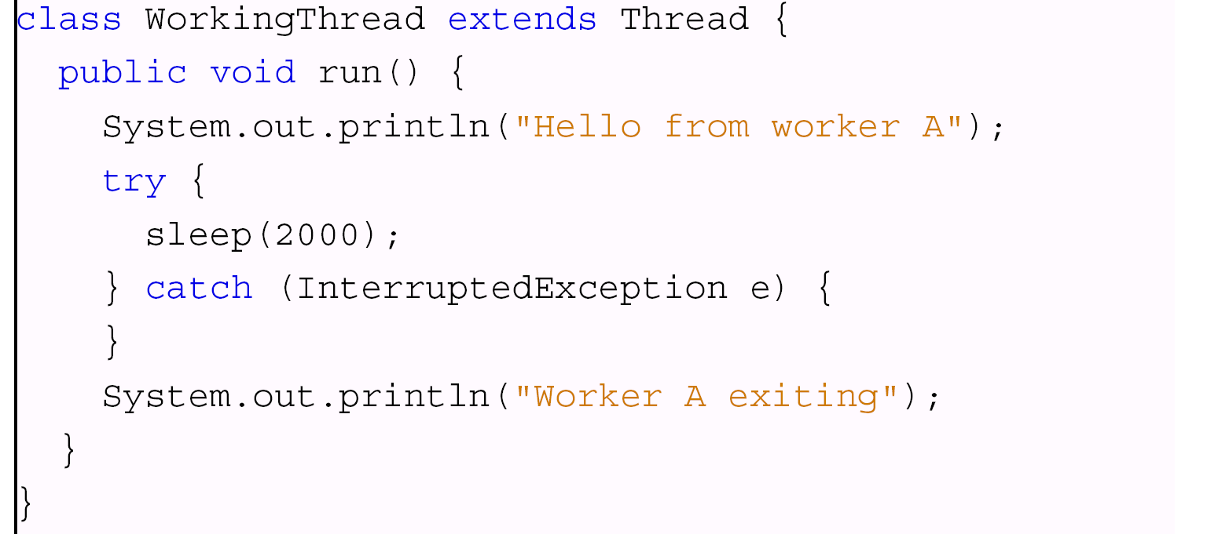
Simple Java Example
19
Swansea University
Benjamin Mora

Slide 20
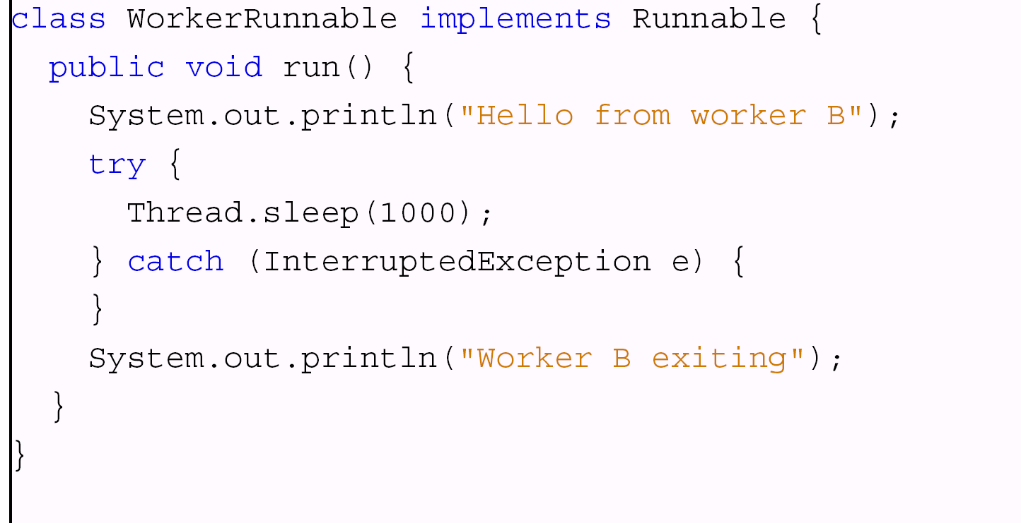
Simple Java Example
20
Swansea University
Benjamin Mora

Slide 21
Simple Java Example
21
Swansea University
Benjamin Mora

Slide 22
Output
Workers started
Hello from worker B
Hello from worker A
Worker B exiting
Worker A exiting
Workers finished
22
Swansea University
Benjamin Mora

Slide 23
Or possibly (!)
Hello from worker B
Workers started
Hello from worker A
Worker A exiting
Worker B exiting
Workers finished
23
Swansea University
Benjamin Mora

Slide 24
Process vs Program
A process is an instance of a Program running.
A process is not a program!
A Process is dynamic.
The program is fixed at compilation time, before running it.
The same program can be run several times, creating as many processes:
1 powerpoint.exe file!
Many PowerPoint windows!
Processes do not usually share memory space and are isolated from each other.

Slide 25
Processes and Threads
A thread is similar to a process, but usually shares memory with other threads.
The difference is made when instantiating (i.e., creating) the process/thread (See later).
Groups of threads usually share (the virtual) memory space and can access each other’s memory.
They must have a common thread/process ancestor.
Separate memory stacks!
Memory stack mainly used to store local variables of a function.
25
Swansea University
Benjamin Mora

Slide 26
Memory From a Process Point of View Process Image
Process Control Block
Logical Address
(virtual memory)
Program
Heap (Data)
Global variables &
dynamically allocated memory
Top of Stack
Stack
Local Variables for current function call
26
Swansea University
Benjamin Mora

Slide 27
The memory Stack: Storing local variables Example: A recursive function
program
Thread’s Stack
Memory Stack
int PowerOfTwo(unsigned int n)
{
if (n==0)
return 1;
else return
2*PowerOfTwo(n-1);
}
…
PowerOfTwo(3);
return: 8
PowerOfTwo: 3
return: 4
PowerOfTwo: 2
return: 2
PowerOfTwo: 1
return: 1
PowerOfTwo: 0
27
Swansea University
Benjamin Mora

Slide 28
Memory Stack
Stores local variables
As a function can be called at any time (non-deterministically).
Is duplicated for each thread/process.
Changes dynamically
Push/pops operations.
Returned values are pushed onto the stack.
Has limited size.
Large variables should be dynamically allocated on most systems/with most languages.

Slide 29
Memory From a Process Point of View
Function Calls as handled by programs & processors:
Push arguments and return address onto the stack.
Jump to function code address (PC register).
Execute Function.
Push Result onto the stack.
Jump Back.
Specific hardware acceleration on processors.
29
Swansea University
Benjamin Mora

Slide 30
Processes and Threads
Multi-tasks operating systems quickly swap the different processes that are running on a computer (Pseudo-parallelism).
To do so, some information related to the process must be stored by the OS.
The Process Control Block (PCB) stores different attributes related to the process. This is a fundamental data structure!
The Process Image consists of a memory block (Heap), the code to be executed, one or many thread stacks, and the PCB.
All processes are stored in a process table.
30
Swansea University
Benjamin Mora

Slide 31
Process Control Block
Identifiers:
Unique Process identifier (Usually an integer).
Parents and Children process identifiers.
User identifier.
CPU registers need to be saved during a context switch:
Registers, program counter, stack pointer, flags, etc…
Scheduling and State information:
Process state, priority, resources used…
31
Swansea University
Benjamin Mora

Slide 32
Context Switching
Context Switching swaps the current process(es) running on the CPU.
How does it work ?
easy solution:
Save current process state.
Load a new process state.
32
Swansea University
Benjamin Mora

Slide 33
Context Switching
Well not so easy!
States:
Register content => Written to memory!
Memory => Page table modified!
I/O ports => Kernel data structure updated!
Determining the new process to be run is called Scheduling!
Details will come later!
33
Swansea University
Benjamin Mora

Slide 34
Remember Java Threads
34
Swansea University
Benjamin Mora
Notes:
From a User point of view

Slide 35
Process States: 5-state model
35
Swansea University
Benjamin Mora
Notes:
From an Operating System point of view

Slide 36
Process States
Running.
The process is running on the CPU.
Ready.
The process could use a CPU if one were available.
Blocked.
The process is waiting for some event (typically a completion of an I/O request).
Suspended Ready.
The process is swapped out to secondary storage, waiting to be resumed.
Suspended Blocked.
The process is swapped out to secondary storage, waiting either for some event, or to be resumed.
36
Swansea University
Benjamin Mora

Slide 37
Process States
Having a two or three state model is possible as well.
Less efficient.
Virtual memory is better handled with 5 states.
There is usually a process queue associated with every state.
Scheduling will be see later.
37
Swansea University
Benjamin Mora

Slide 38
Process Creation
By loading a specified program:
Creation of a new process.
Loading of the program.
Activation of the process.
By duplication from a parent process (fork function under UNIX):
A new process is created.
All the parental data is usually inherited (copy).
Including stack.
A hierarchy of process is then possible.
Killing a process will also usually kill its children.
May take a huge number of cycles.
38
Swansea University
Benjamin Mora

Slide 39
Inter-Process Communication (IPC)
Communication between processes is often wished.
Parallelized algorithms.
Multithreaded programs.
There are several ways to make processes communicate (detailed later in the course).
Signals.
Pipes (and files).
Shared memory.
Message passing.
Remote Procedure Calls.
Sockets.
MPI (not really seen here)
…
39
Swansea University
Benjamin Mora

Slide 40
Threads
40
Swansea University
Benjamin Mora

Slide 41
Thread Creation
Very similar to processes, but:
A process can “contain” many threads.
The threads have access to the same memory data as the parent process, but each thread gets its own stack (processes also get a stack).
Benefits:
Creation is then much faster.
Inter-Process Communication is easy.
Inter-Thread Communication actually!
Though we must be careful when doing so.
41
Swansea University
Benjamin Mora

Slide 42
Relationships between threads and processes (OS Specific)
Threads : Processes
1:1
Each thread is a unique process (UNIX)
M:1
A process has both a defined address space and resources. (Windows, Linux, etc…)
1:M
A thread can migrate from one process to another (Ra (clouds), Emerald).
M:N
Combines the last two cases. (TRIX, IBM NGPT)
42
Swansea University
Benjamin Mora
Notes:
1:1 more or less
More expensive context Switch => picture

Slide 43
Threads
Lightweight processes (kernel threads).
Shared memory.
Same address space.
Global variables are the same.
Separate stack.
Local variables are usually different.
Faster creation.
43
Swansea University
Benjamin Mora
Notes:
Quick reminder 1 running code, 1 processor.
Role of the Stack

Slide 44
Two Types of threads
User threads:
The kernel (E.G., OS) is not aware of any thread, and is only involved in the management of the parent process.
Everything related to the thread management is done by the program itself, without any call to kernel subroutines.
Scheduling.
Communications.
Requires a thread library.
44
Swansea University
Benjamin Mora
Notes:
Mention blocking system calls is a problem…
Running in non-privileged code
User space
M:1 P167 stallings\

Slide 45
Two Types of threads
User threads:
No kernel mode privileges.
Save 2 mode switches.
Context switching only involves loading/saving CPU registers.
Scheduling can be application specific.
Several threads can be in a running mode at the same time.
Well only one get the cpu at a given time…
45
Swansea University
Benjamin Mora
Notes:
User space
M:1 P167 stallings\

Slide 46
Two Types of threads
User threads:
System calls are an issue.
OS (Kernel) invoked.
Blocking other threads.
Jacketing.
Blocking calls become non-blocking calls.
Try again later instead of waiting.
Threads can only be run on a single CPU/core.
46
Swansea University
Benjamin Mora
Notes:
User space
M:1 P167 stallings\

Slide 47
Two Types of threads
Kernel threads:
Managing threads is done by the system scheduler itself.
An Application Programming Interface (API) must be used by the programmer.
Thread switching can be slower.
Available on most systems.
47
Swansea University
Benjamin Mora
Notes:
1:1 more or less
More expensive context Switch => picture

Slide 48
Loading & Linking
48
Swansea University
Benjamin Mora

Slide 49
Loading & Linking
Let’s imagine a single line of (C) code:
static int variable;
How is this variable located at run-time?
(address binding)
Memory
Process Address
}
Process
Libraries
Linker
Loader
Compilation
Module
File.c
File.o
49
Swansea University
Benjamin Mora

Slide 50
Loading & Linking
The compiler cannot always know in advance where the program and its data will be located.
Symbolic addresses used instead in assembly code.
The loader charges the program in memory.
Absolute loading: Module always located at the same place.
Real address in RAM.
Relocatable loading: Handle addresses relative to the starting point of the module.
The norm on a modern computer.
50
Swansea University
Benjamin Mora
Notes:
Add Magic Numbers

Slide 51
Loading & Linking
Different types of Linking after compilation:
Static linking.
Duplicate specific libraries.
Must be available at compilation time.
Dynamic linking.
One instance of the library running.
Updates can be done to libraries without recompiling program!
May save library by handling only once instance of code for all the running programs.
An update may break your program though if your program does not respect specs or if a bug has been introduced.
51
Swansea University
Benjamin Mora

Slide 52
Interrupts
52
Swansea University
Benjamin Mora

Slide 53
Interrupts
An interrupts is a CPU mechanism to help with the parallelization of tasks.
When an interrupt is raised, the mechanism is usually as follows:
The current program state is saved (including CPU registers) in order to be able to continue the program execution later on.
The appropriate Interrupt handler (i.e., a specific program) is called.
53
Swansea University
Benjamin Mora

Slide 54
Interrupts
Different types of interrupts:
I/O devices such as I/O completion, I/O errors and I/O ready.
Disks for buffered disk access.
Network devices for network communications.
Machine errors (or machine check) such as power cut, hardware failure, etc.
Timer. Expiration of a given amount of time.
Terminals, such as interrupt key, restart key, etc.
Software interrupts. Caused by execution of a particular machine instruction.
Traps/Exceptions such as division by zero, arithmetic overflow, …
Supervisor call. Occurs (on some systems) when a running process requires a system call.
54
Swansea University
Benjamin Mora

Slide 55
Interrupts : Exceptions.
Faults:
Must be fixed before current instruction.
E.g., page fault.
Traps:
Must be fixed after instruction.
E.g., Breakpoint, overflow , divide-by-zero.
Switch to kernel mode.
Abort:
E.g., is_computer_on_fire() system call.
Not recoverable.
Not handled exception, exception in exception
55
Swansea University
Benjamin Mora

Slide 56
Interrupt Priorities: Example
Power Failure. Level 8.
Hardware traps. Level 7.
Clock. Level 6.
Keyboard. Level 5.
Serial I/O. Level 4.
Disk Driver. Level 3.
Tape Driver. Level 2.
Printer. Level 1.
Software interrupts. Level 0.
56
Swansea University
Benjamin Mora

Slide 57
Interrupts Levels
An interrupt can be interrupted by another interrupt only if the new one is of higher level.
An interrupt vector/table is associated with the interrupts. For each level corresponds an entry in the table. The entry is usually just a pointer to the routine in charge of processing the interrupt.
57
Swansea University
Benjamin Mora

Slide 58
Programming With Threads in C++11
58
Swansea University
Benjamin Mora

Slide 59
Background
C++11, C++14, C++17
Moved C++ into new programming concepts.
Many new components part of the language:
Threads
Mutexes
Units
Etc..
59
Swansea University
Benjamin Mora

Slide 60
Thread Creation
Very Simple from C++11 on (or java)!
void threadCode(int id) {
std::cout << "Hello World from " << id << std::endl;
}
int main() {
//Launch a thread
std::thread t (threadCode,1);
//Join the thread with the main thread
t.join();
return 0;
}
60
Swansea University
Benjamin Mora

Slide 61
Programming Processes and Threads in C: Quick Overview
61
Swansea University
Benjamin Mora

Slide 62
Background
POSIX library for UNIX environments.
Portable Operating System Interface.
Many “non-native” Functionalities:
Threads
Mutexes
Signals
Pipes
Etc..
62
Swansea University
Benjamin Mora

Slide 63
Processes: UNIX Fork Example
main() {
int pid;
pid=fork();
switch (pid) {
case -1: printf(“An error has occurred\n”); break;
case 0: printf(“I am the child process\n”); break;
default: printf(“My child is %d\n”, pid); break;}
}
Possible output result on stdout
I am the child process
My child is 1234
63
Swansea University
Benjamin Mora
Notes:
Fork not so common anymore. Clone() command. Stdout described later

Slide 64
Processes: Wait function
int wait(int *status);
Force the parent process to wait for a child to stop or terminate.
returns -1 if an error has occurred.
Returns the PID of the child process that ended otherwise.
The exit status is passed to the argument.
The wait command can be useful as it does not waste CPU resources (process puts on hold).
64
Swansea University
Benjamin Mora

Slide 65
Processes: Running External Commands
Exec functions:
execl, execv, execle, execv, execvp.
Allows running a new command from the program.
The current process image is replaced by the new one.
The exec function call never returns unless if running the new command has failed.
Prototypes:
int execlp(const char *file, const char *arg, ...);
int execv(const char *path, char *const argv[]);
…
65
Swansea University
Benjamin Mora

Slide 66
POSIX Threads (PThreads)
Originally, there were as many thread libraries as there were UNIX systems.
IEEE standardized it with POSIX threads in 1995.
Ease portability.
Also known as PThreads.
#include <pthread.h>
Compilation: -pthread option
66
Swansea University
Benjamin Mora

Slide 67
POSIX Threads in C : A Typical Use
pthread_barrier_init
pthread_create
Called x times
Thread 1 running
…
Thread x running
pthread_barrier_wait
…
pthread_barrier_wait
One thread merges intermediate results
pthread_barrier_wait
…
pthread_barrier_wait
Thread 1 running
…
Thread x running
pthread_exit
pthread_exit
pthread_join
pthread_barrier_destroy
Swansea University
Benjamin Mora
67

Slide 68
Creating a new thread
int pthread_create (
pthread_t *thread,
const pthread_attr_t *attr,
void (*start_routine)(void*),
void *arg);
The first argument (thread) returns the thread attributes at the address pointed by thread.
The second argument (attr) represent the attributes needed for the thread creation.
NULL can be used for using default attributes.
68
Swansea University
Benjamin Mora

Slide 69
Creating a new thread
int pthread_create (
pthread_t *thread,
const pthread_attr_t *attr,
void (*start_routine)(void*),
void *arg);
Third attribute represents the starting point function.
Takes a void* argument.
Can be seen as the thread’s “main”.
arg represents a pointer to a possible list of arguments.
Up to the programmer to decide how to use it!
Can also be used to pass a single (casted) integer value!
Returned value is either 0 (OK) or the error code.
69
Swansea University
Benjamin Mora

Slide 70
Exiting a Thread
void pthread_exit(void *value_ptr);
value_ptr can be used to return a value to any code waiting for the termination.
In the main process, pthread_exit must be called (instead of exit or return) before its termination.
If not, the threads that are still running shall be killed as well.
pthread_join
Wait for a specific thread completion.
70
Swansea University
Benjamin Mora

Slide 71
Example:
#include <stdio.h>
#include <pthread.h>
void *message(void *arg) {
printf(“%s\n”,((char *) arg));
pthread_exit(NULL);
}
main() {
pthread_t attrib[2];//….
pthread_create (attrib, NULL, message, (void *) “Child #1”);
pthread_create (attrib+1,NULL, message, (void *) “Child #2”);
pthread_exit(NULL);
}
Result:
child #2
child #1
71
Swansea University
Benjamin Mora
Notes:
Add barriers

Slide 72
Barriers:
#include <stdio.h>
#include <pthread.h>
int nbProcess=4;
Barrier initialization before running some threads…
pthread_barrier_t barrier;
pthread_barrier_init(&barrier, NULL, nbProcesses);
Then call wait inside a running thread whenever suitable…
pthread_barrier_wait(&barrier);
Destroy barriers when not needed anymore. After pthread_join…
pthread_barrier_destroy(&barrier);
72
Swansea University
Benjamin Mora

